Slide 1
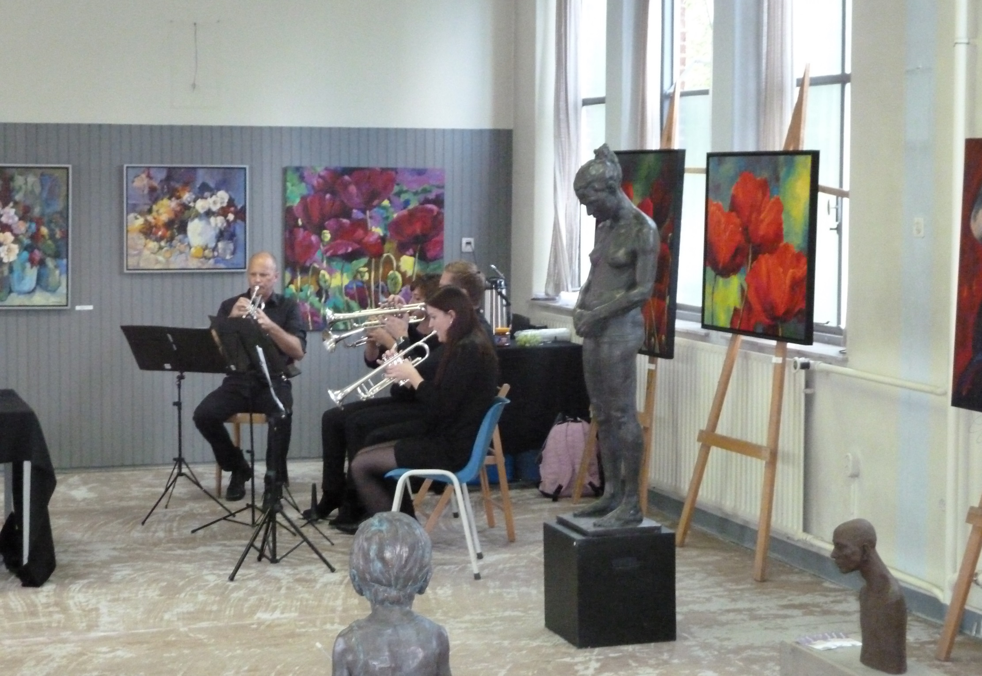
IMPRESSIES KUNSTROUTE OIRSCHOT 2014

Slide 3
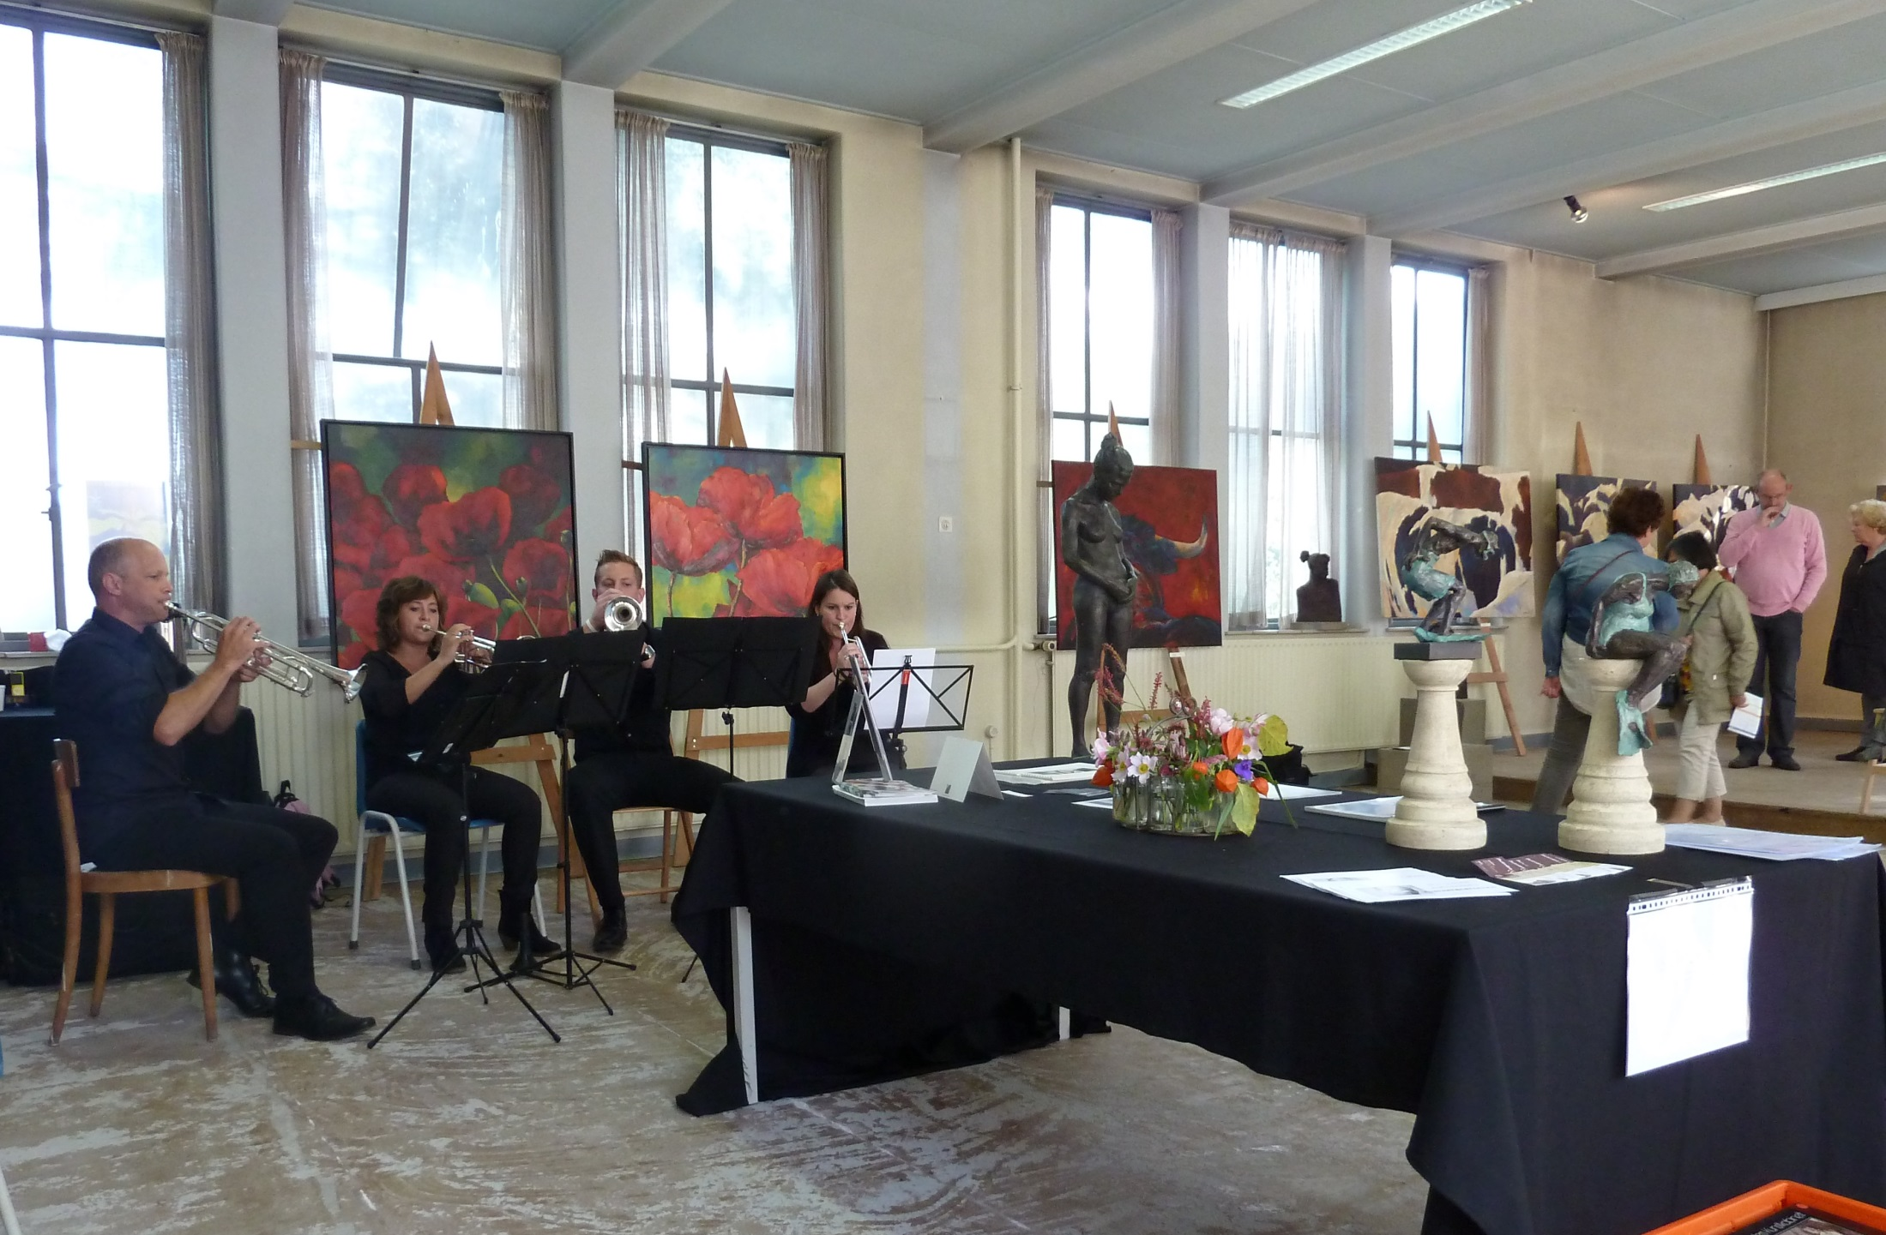

Slide 5
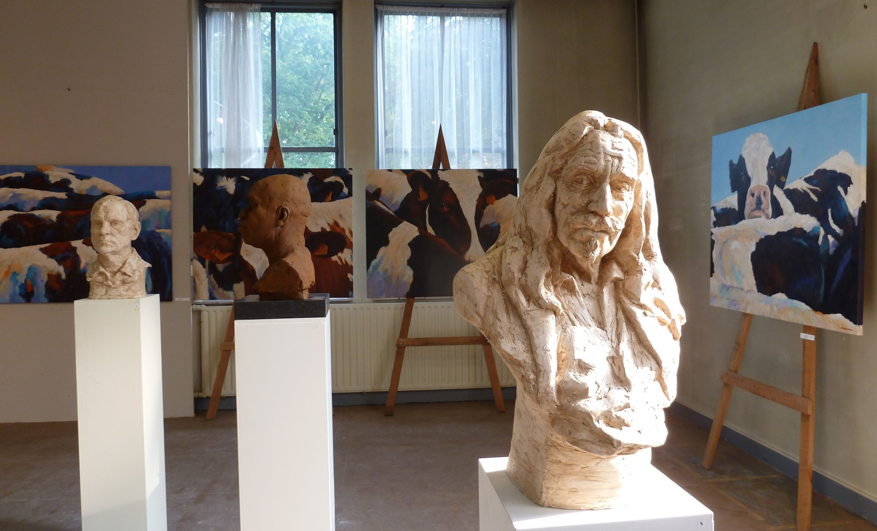

Slide 6
